Slide 1
Computer Science Project
Billing App

Slide 2

INTRO
We made a billing app using python. We used python modules like Tkinter for GUI(Graphical User Interface) and MySQL connector to save and alter the bill in the MySQL database.

Slide 3
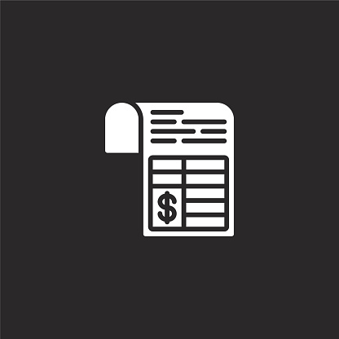
Basic Algorithm
Establishing connectivity between Python and MySql.
Prepare GUI for the app.
Code for basic functions like:-
Displaying older bills from database,
Adding a new bill to database,
Modifying an existing bill from database,
Deleting an item from bill,
Deleting an entire bill.

Slide 4

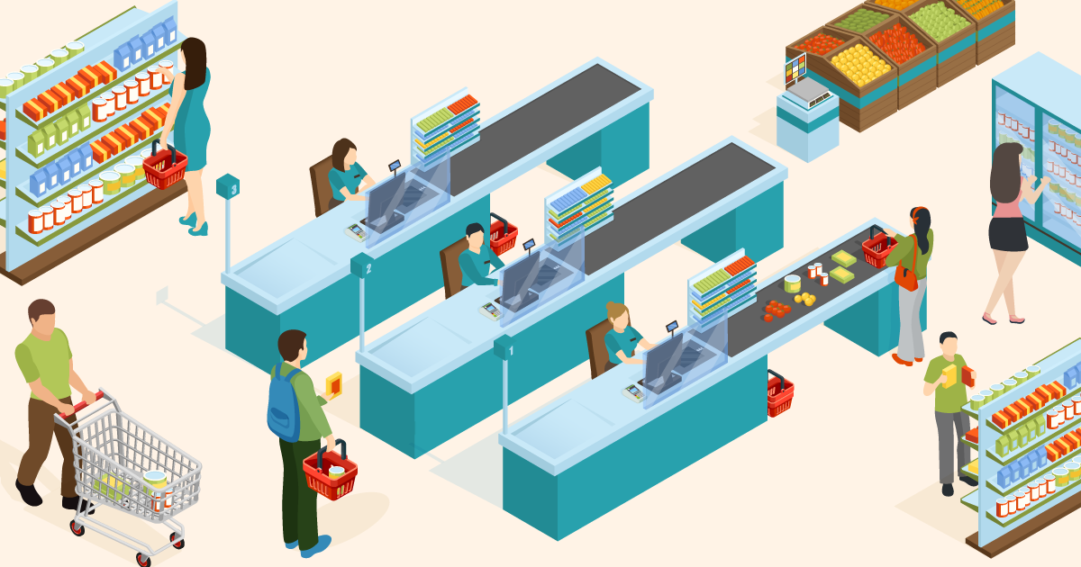
Use Cases Of This Product
This app can be used in all places where billing software. This type of software is generally used in grocery shops, supermarkets, household products, etc. With some alteration to the code it can also be used in hospitals to record incoming and outgoing patients.

Slide 5

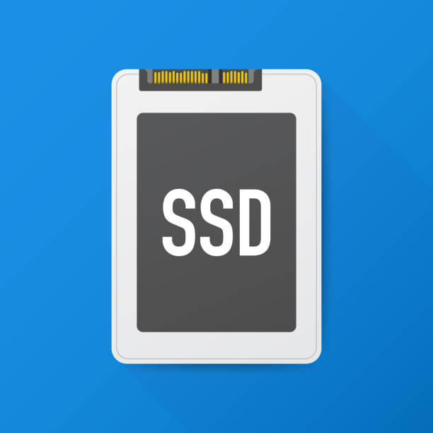
Hardware Requirements
CPU compatible with your OS(Arm 64 bit, X86 64 bit, etc. preferably quad core).
Minimum of 4 GB of ram.( 8 is recommended).
Minimum of 16 GB of free space in primary storage

Slide 6



Software Requirements
Operating system of your choice(Linux, MacOS, Windows;Preferably Linux).
Python 3.7 or greater.
MySQL version 5.6, 5.7, 8.0 or greater.
Tkinter(preferably higher version).
Mysql connector for python(higher version).

Slide 7

Thank You
Done by devs:-
Abhishek
Arudhran
Hemanth Kumar

